Slide 1
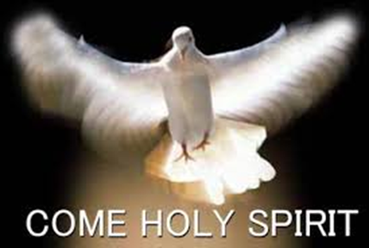
Gifts and fruits of the Holy Spirit
Te Puna O Wai Ora 2019;
Bernie Townsend

Slide 2
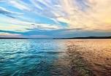
Jesus impresses on us the importance of His Holy Spirit
John 3:1-21 .. Nicodemus
³ Jesus replied, “Very truly I tell you, no one can see the kingdom of God unless they are born again”
⁵ Jesus answered, “Very truly I tell you, no one can enter the kingdom of God unless they are born of water and the Spirit. Flesh gives birth to flesh, but the Spirit gives birth to spirit.
Notes:
Jesus Teaches Nicodemus
3 Now there was a Pharisee, a man named Nicodemus who was a member of the Jewish ruling council. ² He came to Jesus at night and said, “Rabbi, we know that you are a teacher who has come from God. For no one could perform the signs you are doing if God were not with him.”
⁴ “How can someone be born when they are old?” Nicodemus asked. “Surely they cannot enter a second time into their mother’s womb to be born!”
You should not be surprised at my saying, ‘You[c] must be born again.’ 8 The wind blows wherever it pleases.
You hear its sound, but you cannot tell where it comes from or where it is going. So it is with everyone born of the Spirit.”^{[d]}
Birth of water and the Spirit.
Baptised in water and also in the Holy Spirit.
Who has not been baptised in … water ……..in the Holy Spirit???
Baptised => totally immersed like dyeing a garment all over; come out new creations, different.
Consider how different things were for you from that point.

Slide 3
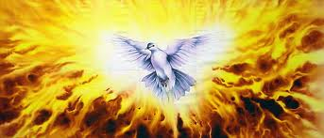
Jesus Promised His Holy Spirit to us
John 14 . His advocate …lives inside of you
Notes:
John 14
If you love me, keep my commands. ¹⁶ And I will ask the Father, and he will give you another advocate to help you and be with you forever— ¹⁷ the Spirit of truth.
The world cannot accept him, because it neither sees him nor knows him. But you know him, for he lives with you and
will be[c] in you. ¹⁸ I will not leave you as orphans;²⁶ But the Advocate, the Holy Spirit, whom the Father will send in my name, will teach you all things and will remind you of everything I have said to you.
Personal and intimate .. For each one of us.

Slide 4
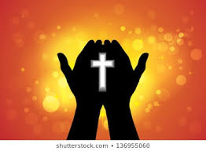
The Work of the Holy Spirit – according to Jesus
John 15
He will testify about me(Jesus).
John 16: 13
He will guide you into all the truth
He will tell you what is yet to come.
John 16:14
He will glorify me (Jesus)
Notes:
Ab
²⁶ “When the Advocate comes, whom I will send to you from the Father—the Spirit of truth who goes out from the Father—He will testify about me.
John 16: 13
But when He, the Spirit of truth, comes, He will guide you into all the truth. He will not speak on his own; He will speak only what He hears, and He will tell you what is yet to come.
John 16:14 He will glorify me because it is from me that He will receive what He will make known to you.
John 16:15 All that belongs to the Father is mine. That is why I said the Spirit will receive from me what He will make known to you.”
out intimacy with Jesus

Slide 5
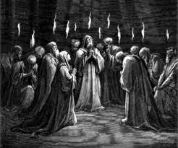
Jesus said : await the Holy Spirit..
Acts 1
“Do not leave Jerusalem, but wait for the gift my Father promised, which you have heard me speak about.
In a few days you will be baptized with the Holy Spirit.”
But you will receive power
when
the Holy Spirit comes on you;
and
you will be My witnesses … to the
ends of the earth.”
Notes:
On one occasion, while he was eating with them, he gave them this command: “Do not leave Jerusalem, but wait for the gift my Father promised, which you have heard me speak about.⁵ For John baptized with water, but in a few days you will be baptized with the Holy Spirit.”
Then they gathered around him and asked him, “Lord, are you at this time going to restore the kingdom to Israel?”
⁷ He said to them: “It is not for you to know the times or dates the Father has set by his own authority.
⁸ But you will receive power when
the Holy Spirit comes on you; and
you will be my witnesses in Jerusalem,
and in all Judea and Samaria, and to the
ends of the earth.”
Not fully a covering, but an empowering
The movement is His, from Him and of Him

Slide 6
Concerning Spiritual Gifts
1 Corr 12
Now about the gifts of the Spirit, brothers and sisters, I do not want you to be uninformed…
⁴ There are different kinds of gifts, but the same Spirit distributes them. ⁵ There are different kinds of service, but the same Lord. ⁶ There are different kinds of working, but in all of them and in everyone it is the same God at work.
⁷ Now to each one the manifestation of the Spirit is given for the common good. ⁸ To one there is given through the Spirit a message of wisdom, to another a message of knowledge by means of the same Spirit, ⁹ to another faith by the same Spirit, to another gifts of healing by that one Spirit, ¹⁰ to another miraculous powers, to another prophecy, to another distinguishing between spirits, to another speaking in different kinds of tongues,^{[a]} and to still another the interpretation of tongues.^{[b]}
¹¹ All these are the work of one and the same Spirit, and he distributes them to each one, just as he determines.
Notes:
Who is aware of the gifts of the Spirit which you have personally received?
Who speaks in tongues, how often (hourly, daily, frequently, occasionally.
Who has interpretation of the tonguse they and others speak.

Slide 7
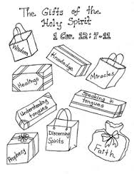
The gifts of the holy Spirit

Slide 8
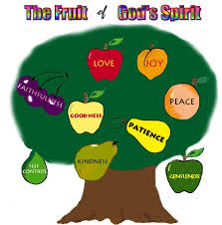
The fruits of the Spirit
Galatians 5:22-23
²² But the fruit of the Spirit
is love, joy, peace,
forbearance, kindness,
goodness, faithfulness,
²³ gentleness and
self-control.
Against such things there is
no law
Notes:
Gifts and fruits go together – they represent the characteristics of the Holy Spirit.
Can’t or shouldn’t have one without the other!
Recognise the devlopment of these fruits in you and your life

Slide 9
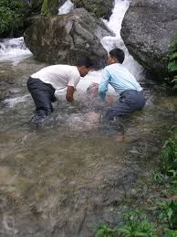
Gifts are for our use – as evidence (of Jesus)
Hebrews 2:4
1 Timothy
1 Peter 4:10
Notes:
We all need to expect, seek, and use His package of gifts for us
Heb 2:4
God also testified to it by signs, wonders and various miracles, and by gifts of the Holy Spirit distributed
1 Tim 4:14
Neglect not the gift that is in thee, which was given thee by prophecy, with the laying on of the hands of the presbytery. 15 Meditate upon these things; give thyself wholly to them; that thy profiting may appear to all. 16 Take heed unto thyself, and unto the doctrine; continue in them: for in doing this thou shalt both save thyself, and them that hear thee.
1 Peter 4:10
"Each of you should use whatever gift you have received to serve others, as faithful stewards of God's grace in its various forms

Slide 10

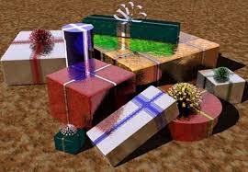
Hindrances to using the Gifts of the Holy Spirit
2 Corr 6:1
Rev 2:1; 2:18
Matt 7; 21-23
Notes:
2 Corinthians 6:1 6 As God's co-workers we urge you not to receive God's grace in vain.
Revelation 21"To the angel ^{[1]} of the church in Ephesus write: These are the words of him who holds the seven stars in his right hand and walks among the seven golden lampstands: 2I know your deeds, your hard work and your perseverance
Rev 2:18
"To the angel of the church in Thyatira write: These are the words of the Son of God, whose eyes are like blazing fire and whose feet are like burnished bronze.19I know your deeds, your love and faith, your service and perseverance, and that you are now doing more than you did at first.
Matthew 7:21-23 I Never Knew You - “Not everyone who says to Me, 'Lord, Lord,' shall enter the kingdom of heaven, but he who does the will of My Father in heaven
A present a gift ..refused
Hearts .. Not works,
Covering and forgiveness, not empowerment

Slide 11

1. Things we already know about people or circumstances - Ananias
Ananias answered, “I have heard many reports about this man and all the harm he has done to your holy people in Jerusalem. ¹⁴ And he has come here with authority from the chief priests to arrest all who call on your name.”
Notes:
In Damascus there was a disciple named Ananias. The Lord called to him in a vision, “Ananias!” “Yes, Lord,” he answered.
¹¹ The Lord told him, “Go to the house of Judas on Straight Street and ask for a man from Tarsus named Saul, for he is praying. ¹² In a vision he has seen a man named Ananias come and place his hands on him to restore his sight.”
H
¹⁵ But the Lord said to Ananias, “Go! This man is my chosen instrument to proclaim my name to the Gentiles and their kings and to the people of Israel. ¹⁶ I will show him how much he must suffer for my name.”
at we know could hinder our reaching out

Slide 12
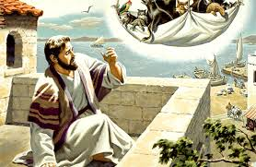
2. Previous belief systems - Peter
Acts 10:9-21
¹⁴ “Surely not, Lord!” Peter replied. “I have never eaten anything impure or unclean.”
Notes:
⁹ About noon the following day as they were on their journey and approaching the city, Peter went up on the roof to pray. ¹⁰ He became hungry and wanted something to eat, and while the meal was being prepared, he fell into a trance.¹¹ He saw heaven opened and something like a large sheet being let down to earth by its four corners. ¹² It contained all kinds of four-footed animals, as well as reptiles and birds. ¹³ Then a voice told him, “Get up, Peter. Kill and eat.”
¹⁵ The voice spoke to him a second time, “Do not call anything impure that God has made clean.”
¹⁶ This happened three times, and immediately the sheet was taken back to heaven.
¹⁹ While Peter was still thinking about the vision, the Spirit said to him, “Simon, three^{[a]} men are looking for you. ²⁰ So get up and go downstairs. Do not hesitate to go with them, for I have sent them.”
²¹ Peter went down and said to the men, “I’m the one you’re looking for. Why have you come?”
What we were brought up with, used to know, can prevent us from using His spiritual gifts

Slide 13
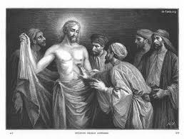
3. Doubts - Thomas
Thomas - John 20:26-31
“Put your finger here; see my hands. Reach out your hand and put it into my side. Stop doubting and believe.”
Notes:
²⁶ A week later his disciples were in the house again, and Thomas was with them. Though the doors were locked, Jesus came and stood among them and said, “Peace be with you!” ²⁷ Then he said to Thomas,
²⁸ Thomas said to him, “My Lord and my God!”
²⁹ Then Jesus told him, “Because you have seen me, you have believed; blessed are those who have not seen and yet have believed.”
Doubts, fear, political correctness.
Obedience to Him is paramount.
“You are not too old, too tired, too weak with age; He doesn’t seem to me to view us as an aged church of people; God sees us as His children, His bride, and He loves each one of us so much; He wants to use you right up to the end of your days. Be open, alert, willing; He won’t use you beyond your capacity to deliver, but He will use you and will gift you accordingly.”

Slide 14
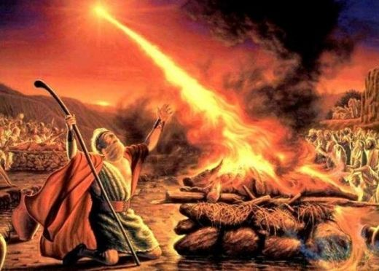
4. Mt. Carmel …Elijah
Notes:
After Elijah's confrontation with Ahab, God tells him to flee out of Israel, to a hiding place by the brook Chorath, east of the Jordan, where he will be fed by ravens.^{[22]} When the brook dries up, God sends him to a widow living in the town of Zarephath in Phoenicia. When Elijah finds her and asks to be fed, she says that she does not have sufficient food to keep her and her own son alive. Elijah tells her that God will not allow her supply of flour or oil to run out, saying, "Do not be afraid...For thus says the Lord the God of Israel: The jar of meal will not be emptied and the jug of oil will not fail until the day that the Lord sends rain on the earth."^{[23]} She feeds him the last of their food, and Elijah's promise miraculously comes true. God gave her "manna" from heaven even while he was withholding food from his unfaithful people in the promised land. Some time later the widow's son dies and the widow cries, "You have come to me to bring my sin to remembrance, and to cause the death of my son!"^{[24]} Elijah prays that God might restore her son so that the trustworthiness of God's word might be demonstrated. 1 Kings 17:22 relates how God "listened to the voice of Elijah; the life of the child came into him again, and he revived."^{[25]} This is the first instance of raising the dead recorded in Scripture. This widow was granted the life of her son, the only hope for a widow in ancient society. The widow cried, "the word of the Lord in your mouth is truth."^{[26]} After more than three years of drought and famine, God tells Elijah to return to Ahab and announce the end of the drought: not occasioned by repentance in Israel but by the command of the Lord, who had determined to reveal himself again to his people. While on his way, Elijah meets Obadiah, the head of Ahab's household, who had hidden a hundred Jewish prophets from Jezebel's violent purge. Obadiah fears that when he reports to Ahab about Elijah's whereabouts, Elijah would disappear, provoking Ahab to execute him. Elijah reassures Obadiah and sends him to Ahab.
Challenge to Baal[edit]
Elijah's offering is consumed by fire from heaven in a stained glass window at St. Matthew's German Evangelical Lutheran Church in Charleston, South Carolina.
When Ahab confronts Elijah, he denounces him as being the "troubler of Israel" but Elijah takes notice of his hypocrisy and tells Ahab that he is the one who troubled Israel by allowing the worship of false gods. Elijah then berates both the people of Israel and Ahab for their acquiescence in Baal worship. "How long will you go limping with two different opinions? If the Lord is God, follow him; but if Baal, then follow him."^{[27]} And the people were silent. The Hebrew for this word, "go limping" or "waver", is the same as that used for "danced" in 1 Kings 18, verse 26, where the prophets of Baal frantically dance. Elijah speaks with sharp irony about the religious ambivalence of Israel.
Elijah proposes a direct test of the powers of Baal and the Jewish God. The people of Israel, 450 prophets of Baal, and 400 prophets of Asherah are summoned to Mount Carmel. An altar is built for Baal. Wood is laid on the altar. An ox is slaughtered and cut into pieces; the pieces are laid on the wood. Elijah then invites the priests of Baal to pray for fire to light the sacrifice. They pray from morning to noon without success. Elijah ridicules their efforts. "At noon Elijah mocked them, saying, 'Cry aloud! Surely he is a god; either he is meditating, or he has wandered away, or he is on a journey, or perhaps he is asleep and must be awakened.'"^{[28]} They respond by cutting themselves and adding their own blood to the sacrifice (such mutilation of the body was strictly forbidden in the Mosaic law). They continue praying until evening without success.
Elijah builds an altar from twelve stones, he digs a huge trench around it, he lays the wood on it, slaughters the ox cuts it up and lays it on the wood, he now orders that the sacrifice and altar be drenched with water from "four large jars" poured three times, filling also the trench.^{[29]} He asks God to accept the sacrifice. Fire falls from the sky, consuming the sacrifice, the stones of the altar itself, the earth and the water in the trench as well. Elijah then orders the deaths of the priests of Baal. Elijah prays earnestly for rain to fall again on the land. Then the rains begin, signaling the end of the famine.
Mount Horeb[edit]
Jezebel, enraged that Elijah had ordered the deaths of her priests, threatens to kill Elijah.^{[30]} Later Elijah would prophesize about Jezebel's death, because of her sin. Elijah flees to Beersheba in Judah, continues alone into the wilderness, and finally sits down under a shrub, praying for death. He falls asleep under the tree; the angel of the Lord touches him and tells him to wake up and eat. When he awakens he finds bread and a jar of water. He eats, drinks, and goes back to sleep. The angel comes a second time and tells him to eat and drink because he has a long journey ahead of him.
Elijah challenges King Ahab (married to Jeezebel
Split the kingdom between them, worshipping and raising prayers to false gods, gods wer in stone statues in Temple and throughout the lands.

Slide 15
Elijah
Elijah Flees to Horeb
The Lord Appears to Elijah
Elijah appoints his successors
Who complete God’s tasks
for the people and the land
Notes:
19 Now Ahab told Jezebel everything Elijah had done and how he had killed all the prophets with the sword. ² So Jezebel sent a messenger to Elijah to say, “May the gods deal with me, be it ever so severely, if by this time tomorrow I do not make your life like that of one of them.”
³ Elijah was afraid^{[a]} and ran for his life. When he came to Beersheba in Judah, he left his servant there, ⁴ while he himself went a day’s journey into the wilderness. He came to a broom bush, sat down under it and prayed that he might die. “I have had enough, Lord,” he said. “Take my life; I am no better than my ancestors.” ⁵ Then he lay down under the bush and fell asleep.
And the word of the Lord came to him: “What are you doing here, Elijah?”
¹⁰ He replied, “I have been very zealous for the Lord God Almighty. The Israelites have rejected your covenant, torn down your altars, and put your prophets to death with the sword. I am the only one left, and now they are trying to kill me too.”
¹⁵ The Lord said to him, “Go back the way you came, and go to the Desert of Damascus. When you get there, anoint Hazael king over Aram. ¹⁶ Also, anoint Jehu son of Nimshi king over Israel, and anoint Elisha son of Shaphat from Abel Meholah to succeed you as prophet. ¹
⁷ Jehu will put to death any who escape the sword of Hazael, and Elisha will put to death any who escape the sword of Jehu. ¹⁸ Yet I reserve seven thousand in Israel—all whose knees have not bowed down to Baal and whose mouths have not kissed him.”

Slide 16
Now, for us all to personally respond to our use of gifts God has given each one to use
Ananias:
Do we know the people well to use the spiritual gifts for them ??
Peter:
Are we being asked to do something we’d rather not do??
Thomas:
Do I really believe God can..??
Elijah:
Am I afraid, do I hide.. ??
Notes:
Is Jesus living fully, in all His glory within us?
Are we living in Jesus times .. With healings and deliverances in abundance?

